Slide 1
CSS transforms, transitions and Animations
IN712 Web 3 2016

Slide 2
In-Browser Animation
When complex animation (i.e. more than multi-frame gifs) hit the web, it was via java applets and flash
Browsers can’t actually render either of these by themselves. They require plug-ins (e.g. Flash Player) which hurt performance, and can be missing or turned off
So HTML5 and CSS3 have introduced animation facilities supported directly by the browser. Like some other features of the new standards, not all of this is supported by all commercial browsers, but lots of it is by many
HTML5 introduces the <canvas> element. This is a normal tag that you drop in just like you drop in a <p> or <div>
The canvas element provides a full range of drawing commands
You use these *from JavaScript*. That is, you pop a canvas into your html, then grab it in JavaScript.
You then invoke its methods in the usual OO way.
We will, therefore, defer discussion of HTML5 canvas animation until we meet JavaScript
Today, we will turn our attention to animation facilities of CSS3
Although not really programmable in the usual sense, you can do quite a lot of pretty amazing stuff with these new properties
HTML5
<canvas>
CSS3
Transforms
Translation
Keyframes

Slide 3
CSS3 Transforms
Transforms
These are ordinary mathematical transforms.
They are not, in and of themselves, animations. However, when combined with transitions and keyframes (as we’ll see in a minute), they are used to generate complex visual behaviours
Translate, rotate, scale and skew
Not animations on their own
Applied directly on render, like other styles
Produce animation when combined with translations and keyframes

Slide 4

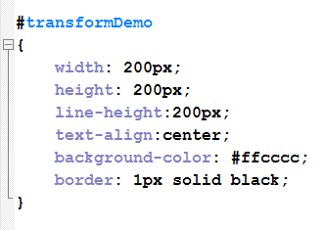
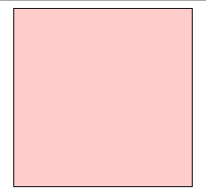
Transforms
Assume this HTML and normal CSS to allow us to see the div
It appears in the browser as shown.
Now we can look at the effect of applying the transform styles.

Slide 5
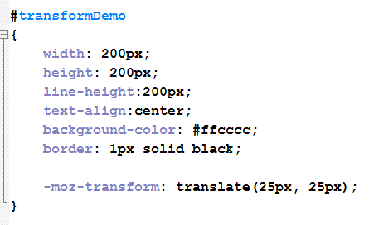
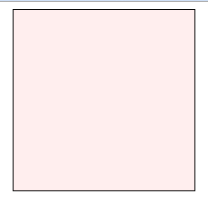
Transforms
Translate
Here we have added the vendor-prefixed transform style.
We give it the value translate which takes two arguments: an x distance and a y distance.
This simply moves the element from its original position
it is sort of like position:relative, but transform: is used for animation, and position: is not.
It is easy to get ‘translate’ and ‘transform’ confused because they sound so similar. Remember that we are applying mathematical transforms (the style) and those, as you know, are translate, rotate and skew (the values).
Original was here….
Adding translate moves it here….

Slide 6
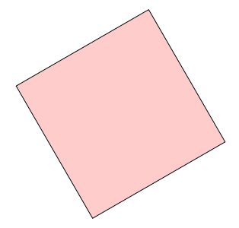
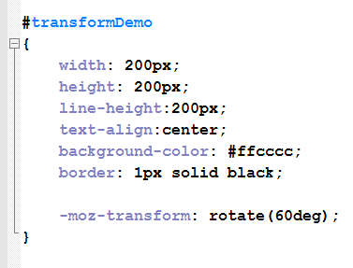
Transforms
Rotate

Slide 7
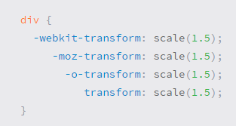
A word about vendor prefixes
the transform property includes multiple vendor prefixes to gain the best support across all browsers.
The un-prefixed declaration comes last to overwrite the prefixed versions, should a browser fully support the transform property.
Vendor prefixes are strongly encouraged for any code in a production environment

Slide 8

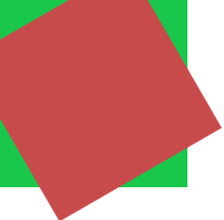
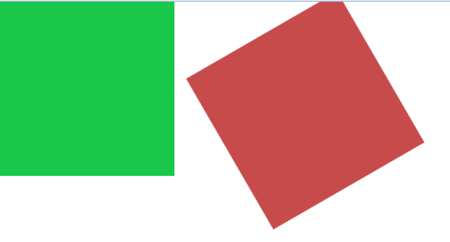

Combining several Transforms
Combining

Slide 9
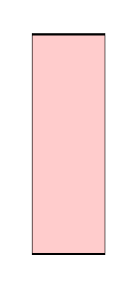
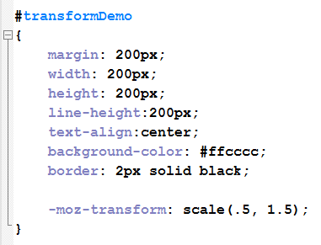
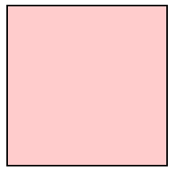
Transforms
Original was this size….
Scale
Adding scale changes it to ….

Slide 10
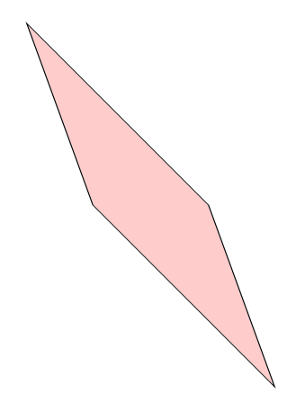
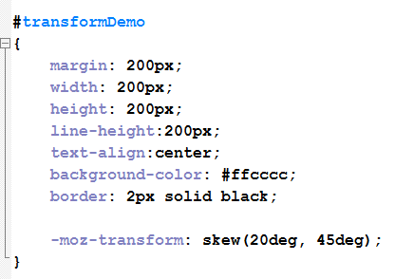
Transforms
Skew

Slide 11
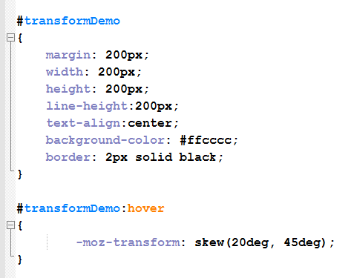
Changing on hover
The simplest way to start animating with transforms is to define different states using the hover pseudoclass
Although we usually only define hover on links, you can actually define it for most elements.
Later, we will see more complicated behaviours with keyframes and javaScript event listeners, but hover is a good way to start experimenting.
Your CSS would look like this…
The screen would start as the regular square, and on mouse over would jump to the skewed version.
To get a proper animation, we need some intermediate frames (tweening).
That’s where the new CSS3 *transition* property comes in….

Slide 12
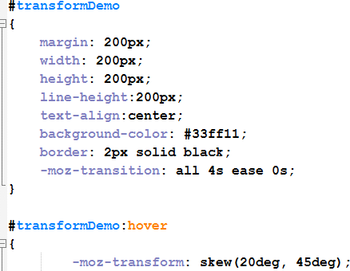
CSS3 Transition
Syntax:
transition: property duration timingFunction delay
You apply transition like any other style. Then when something about the element changes (in this case, because the hover state is raised) that change is implemented with tweening as described by the arguments to transition.
The “transform on hover” behaviour we just saw is a change.
Add transition, and the change (for example, from upright to skewed) gets tweened.
The arguments for transition are:
Property: You can animate individual properties – like width, height, color – separately, but usually you want to animate the whole object. For this, set the property to all
Duration: in seconds (e.g. 4s)
Timing function: describes the easing algorithm (change in speed of movement as you reach the end of the animation). Default is ease. Delay: How long to wait before beginning the change.

Slide 13
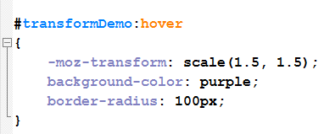
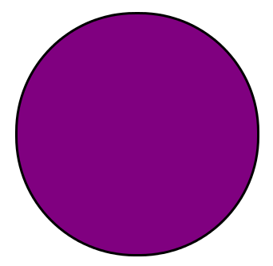
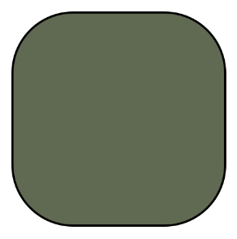
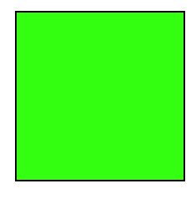
CSS3 Transition
You can animate all kinds of properties, not just the transforms.
For example…with this style on hover and the transition style as shown on the previous slide (all 4s ease 0s)
On mouseover you get a smooth 4 second animation as shown below (here we see only one of the intermediate states)
What do you expect will happen when the mouse is rolled off?

Slide 14
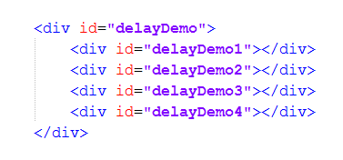
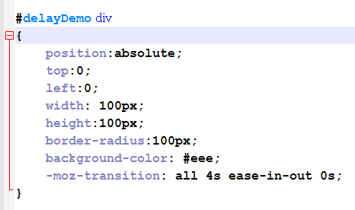
Transition Delay
You can get some interesting effects with delay
For example, assume this HTML
A little styling in the CSS to make them all grey circles sitting on top of each other.
Then give them each a different transform and delay…

Slide 15
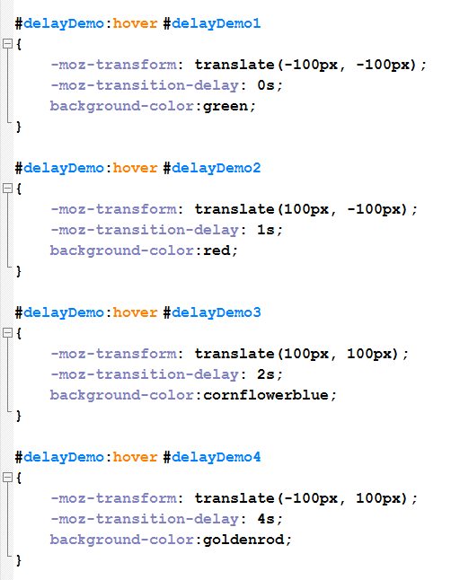
Transition Delay
Then give them each a different transform and delay…
What happens on mouseover? What happens on “unmouseover”? (no delay)
DEMO: #delayDemo

Slide 16
Demo: CSS transforms and transitions
http://liveweave.com/R2ZbN2
http://liveweave.com/KoIsrO

Slide 17
CSS3 Keyframe Animation
Keyframe animation: you can define specific points in an animation, and the browser will tween them for you
This is a two-step process: First we define the animation, then we assign it to an element
Define the animation
@keyframes animationName
{
Keyframe specifications
}
Assign the animation
selector
{
Other styles
animation: name duration timing-function delay iteration-count direction;
}

Slide 18
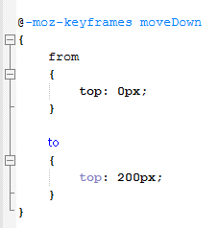
CSS3 Keyframe Animation
Define the animation
Note the @. That is required. The selector without vendor prefix is @keyframes. This is an “at-rule”, or what we would call a compiler directive (more accurately here a parser directive). We will see a couple more during the semester. Here we are really extending the whole concept of a CSS style rule into something much closer to traditional coding.
This defines a simple animation with only two keyframes – starting and ending (we will see in a minute how to get more)
‘from’ and ‘to’ are keywords here, signifying the start and the end of a keyframe definition
You specify a property value for the start frame (from) and a property value for the end frame (to). You could have as many different properties specified as you needed (we’ll see a list of what can be animated in a minute)

Slide 19
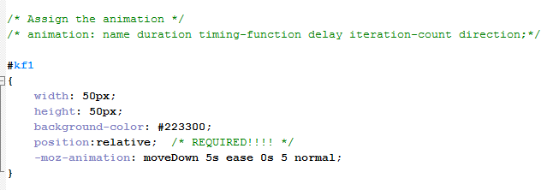
CSS3 Keyframe Animation
Assign the animation

Slide 20
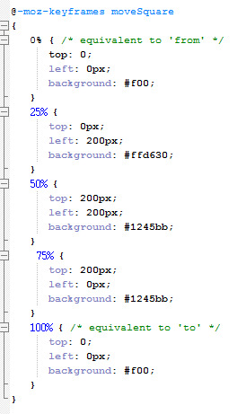
CSS3 Keyframe Animation
Multiple Keyframes

Slide 21
Demo
http://liveweave.com/2Mu1qO

Slide 22
Advanced examples of what can be done with CSS transform, transitions and animations
http://mrdoob.github.io/three.js/examples/css3d_periodictable.html
http://www.creativebloq.com/css3/animation-with-css3-712437
http://demo.marcofolio.net/3d_animation_css3/
http://www.romancortes.com/ficheros/css-coke.html

